Slide 1




Annual Town Meeting
June 1, 2026 • 7:00 PM
Berkley Residents
Explanation of the Warrant Articles
Berkley, MA
Town Meeting
20 Articles

Slide 2

Town of Berkley
Annual Town Meeting
June 1, 2026
What Town Meeting Does
Town Meeting is the legislative body of the Town
Town Meeting = Town's Legislature — Residents vote on budgets, spending, and borrowing
You vote on budgets & spending — Determines what the Town can legally spend and do
Some need simple majority — Most articles require 50%+1 vote Simple Majority
Some need 2/3 vote — Zoning, borrowing, and capital articles require 2/3 majority Two-Thirds
Annual Town Meeting
Berkley, MA
Page 2 of 24

Slide 3
Town of Berkley
Annual Town Meeting
June 1, 2026
ARTICLE 1
Finance Committee Report
Required to start Town Meeting
Simple Majority Vote Required
Annual Town Meeting
Berkley, MA
Page 5 of 24

Slide 4
Town of Berkley
Annual Town Meeting
June 1, 2026
ARTICLE 2
Capital Improvement Planning Committee
Pass Over — Committee lacks quorum
No action needed from voters at this time
Vote Required
Board Recommendation
Simple Majority
PASS OVER
Annual Town Meeting
Berkley, MA
Page 6 of 24

Slide 5

Town of Berkley
Annual Town Meeting
June 1, 2026
Article 3 - Free Cash
Snow & Ice
Personnel
$181,758
$50,000
Capital
Past Bills
Total Amount
$460,731
$1,275
$694,414
Planning Board
$650
Vote: Simple Majority
One-time expenses and FY26 obligations

Slide 6
Town of Berkley
Annual Town Meeting
June 1, 2026
ARTICLE 4
Financial Impact
Fire Apparatus Borrowing
$900,000
Replace 44-year-old fire tanker
Maximum borrowing amount
Holds water for fires - no fire hydrants in town
Recommended by BOS
Plan: Set aside free cash each year
Voting Information
Goal: Purchase in next 5 years
Vote Required
Two-Thirds
Annual Town Meeting
Berkley, MA
Page 7 of 23

Slide 7
Town of Berkley
Annual Town Meeting
June 1, 2026
ARTICLE 5
Override Stabilization Fund
Pass Over - Override failed
This article is being passed over
Vote Required
Status
Simple Majority
Passed Over
Annual Town Meeting
Berkley, MA
Page 9 of 24

Slide 8
Town of Berkley
Annual Town Meeting
June 1, 2026
ARTICLE 6
FY2027 Municipal Operating Budget
Funding Sources
Taxation
$7,334,515
Municipal Operations | July 1, 2026 - June 30, 2027
Free Cash
$140,000
$7.87M
Ambulance Fees
$535,000
$7.33M
$140K
$535K
From Taxation
Free Cash
Ambulance
Total Budget
Total
$7,869,515
Vote Information
Simple Majority Required
PASSED
Annual Town Meeting
Berkley, MA
Page 10 of 24

Slide 9




Town of Berkley
Annual Town Meeting
June 1, 2026
Article 7 - Debt Service
Total Debt Service
$3,867,340
Retirement of Debt
$1,419,799
Town Office Building
$180,000
SBRSD High School
$400,949
Bristol Plymouth HS
$163,850
Berkley Comm. School
$675,000
Interest
$2,447,541
Town Office Building
$59,250
SBRSD High School
$162,634
Bristol Plymouth HS
$429,881
Berkley Comm. School
$1,795,776
Vote: Simple Majority
All amounts funded from taxation

Slide 10



Town of Berkley
Annual Town Meeting
June 1, 2026
Article 8 - School Funding
Berkley K-8
Bristol Plymouth
Total Budget
$8,924,952
$1,395,482
$12,821,271
Health & Insurance
Transportation
$1,238,649
$808,931
Special Ed
Bristol Aggie
$245,000
$208,257
Vote Required: Simple Majority
Includes Berkley K-8 district and regional/vocational obligations

Slide 11
Town of Berkley
Annual Town Meeting
June 1, 2026
ARTICLE 9
Somerset Berkley Regional School
From High School Stabilization Fund
Total Amount
$3.12M
Funds Somerset Berkley Regional High School District
Vote Required
BOS Recommendation
Simple Majority
RECOMMENDED
Annual Town Meeting
Berkley, MA
Page 13 of 24

Slide 12
Town of Berkley
Annual Town Meeting
June 1, 2026
ARTICLE 10
Revolving Funds
Sets spending limits for fee-based accounts
Police Department
$200,000
Plumbing Inspector
$10,000
Board of Health
$60,000
Planning Board
$10,000
School Department
$60,000
Board of Appeals
$5,000
Wiring Inspector
$10,000
Soil Conservation
$5,000
Gas Inspector
$10,000
Simple Majority Vote Required
Annual Town Meeting
Berkley, MA
Page 13 of 23

Slide 13
Town of Berkley
Annual Town Meeting
June 1, 2026
ARTICLE 11
Chapter 90 Road Funding
Accepts state/federal road money
This article allows the Town to accept and enter into contracts for state and federal road funding, including Chapter 90 funds.
Key Point: The town regularly receives Chapter 90 funding for roads, which the Selectmen need to accept and contract for. This authorization is required annually to maintain our ability to improve and maintain town roads.
Vote Required
Board Recommendation
Simple Majority
RECOMMENDED
Annual Town Meeting
Berkley, MA
Page 15 of 24

Slide 14
Town of Berkley
Annual Town Meeting
June 1, 2026
ARTICLE 12
Assessor Tax Maintenance
Authorize Assessors for annual tax maintenance
Rate set at $15.00 per parcel
Paid from Annual Tax Maintenance Account
Simple Majority Vote Required
Annual Town Meeting
Berkley, MA

Slide 15
Town of Berkley
Annual Town Meeting
June 1, 2026
ARTICLE 13
Additional Property
Tax Exemptions
Additional exemptions up to 100%
For: Surviving spouses, Low-income elderly, Blind, Disabled veterans
Annual reauthorization required
Simple Majority Vote Required

Slide 16
Town of Berkley
Annual Town Meeting
June 1, 2026
ARTICLE 14
Board of Health Inspection Fees
Perc hole
$75
Food service
$75
Well
$100
Pumper truck
$75
Sanitation
$150
Other misc
$75
Simple Majority Vote Required
Annual Town Meeting
Berkley, MA
Page 16 of 24

Slide 17

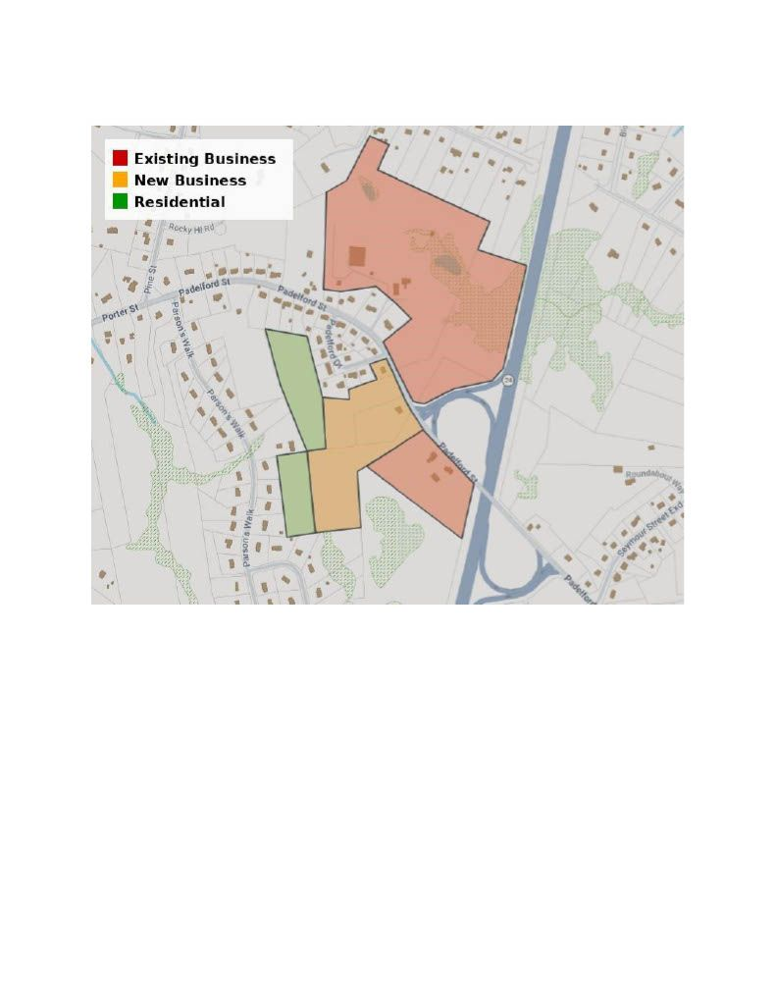
Town of Berkley
Annual Town Meeting
June 1, 2026
ARTICLE 15
Padelford Street Rezoning
Rezone to General Business
31, 33, 35, 35R Padelford Street
Does NOT approve any project
Vote Required
2/3 Majority
Annual Town Meeting | Berkley, MA
Page 16

Slide 18
Town of Berkley
Annual Town Meeting
June 1, 2026
ARTICLE 16
Unclaimed Funds Recovery
• Allows Town to recover abandoned funds
• Streamlines legal process
Simple Majority Vote Required

Slide 19
Town of Berkley
Annual Town Meeting
June 1, 2026
ARTICLE 17
Senior Tax Deferral Expansion
Income limit raised to ~$75,000
Interest reduced: 8% to 6%
This is a deferral, not forgiveness
Simple Majority Vote Required

Slide 20
Town of Berkley
Annual Town Meeting
June 1, 2026
ARTICLE 18
Bed & Breakfast Zoning
Requires Special Permit from Planning Board
2/3 Majority Vote Required
Annual Town Meeting
Berkley, MA
Page 18 of 22

Slide 21
Town of Berkley
Annual Town Meeting
June 1, 2026
ARTICLE 19
Surplus Property Sale
Authorization for Board of Selectmen to evaluate future sale
34 Green Street
44RR Green Street
Map 12, Lot 63 - Former ACO site
Map 12, Lot 62 - 1996 tax taking
Authorizes future sale - no immediate action
Total Acreage
Vote Required
Status
~17 acres
Simple Majority
BOS Recommended
Annual Town Meeting
Berkley, MA
Page 21 of 24

Slide 22
Town of Berkley
Annual Town Meeting
June 1, 2026
ARTICLE 20
Additional Surplus Properties
10 Town-owned properties
Authorizes evaluation for future sale
Requires due diligence before any sale
Simple Majority Vote Required
Annual Town Meeting Berkley, MA
Page 21 of 23

Slide 23
Town of Berkley
Annual Town Meeting
June 1, 2026
Important Reminders
Your participation matters
Town Meeting is the final authority - All budget and policy decisions are made here
Questions are welcome - Ask for clarification on any article
Your participation matters - Your vote directly impacts town operations
Annual Town Meeting
Berkley, MA
Page 23 of 24

Slide 24
Town of Berkley
Annual Town Meeting
June 1, 2026
Questions & Discussion
We welcome your questions on any article
Thank you for participating in Berkley's budget and policy decisions
Annual Town Meeting
Berkley, MA
Page 24 of 24

